Slide 1
Building a Resilient ASP.NET MVC 4 Web Application
Fabiano Nalin
MCP MCT MCSD
fabiano.nalin@gmail.com

Slide 2
Overview
Developing Secure Sites State Management

Slide 3
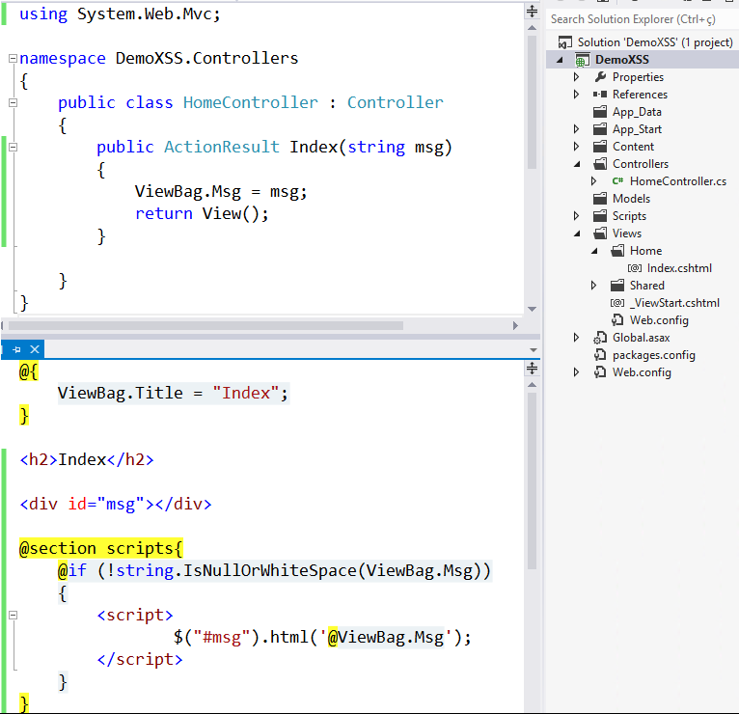
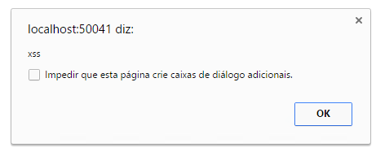
Developing Secure Sites
Cross-Site Scripting (XSS) injeção de scripts maliciosos
http://localhost/Home/?msg=<script>alert('xss')</script>
http://localhost/Home/?msg=\x3cscript\x3ealert(\x27xss\x27)\x3c/script\x3e

Slide 4

Developing Secure Sites
Cross-Site Scripting (XSS)

Slide 5
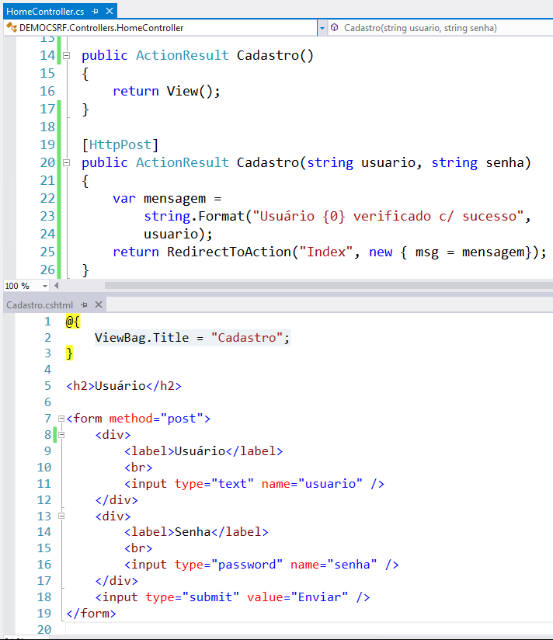
Developing Secure Sites
Cross-site request forgery (CSRF)
requisição falsificada entre sites

Slide 6
Developing Secure Sites
Cross-site request forgery (CSRF)

Slide 7
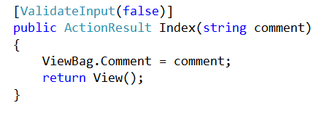
Developing Secure Sites
Disabling Attack Protection
desativar validação da requisição

Slide 8
Developing Secure Sites
Disabling Attack Protection
desativar validação da requisição

Slide 9
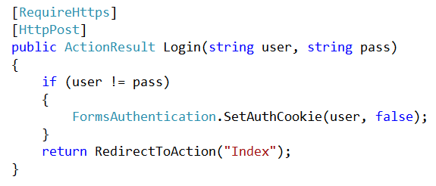
Developing Secure Sites
Secure Sockets Layer
ssl

Slide 10
Developing Secure Sites
Secure Sockets Layer

Slide 11
State Management
O protocolo http é stateless, ou seja, não mantem o estado entre requisições.
Hidden Fields
Cookies
Query strings
TempData
Sessions
InProc mode
StateServer mode
SQLServer mode
Custom mode
Off mode

Slide 12
State Management

